Slide 1


Group Members :
Tareq Khaled 170041067
Ahmed Camara 170041070
Mahamat Djbrine 170041072
Malick Sow 170041073

Slide 2
Blood Bank Management System :
Introduction
The Objectives
The Functional Goals
The Features
The Technologies

Slide 3
Introduction :
Blood Bank Management System :
Blood banks collect, store, and provide blood. Typically, these banks collect blood from voluntary blood donors. The banks then sort blood by type, check blood to make sure it is free of disease and then store it for future use. The main mission of a blood bank is to provide life-saving blood to hospitals and other health care facilities.

Slide 4
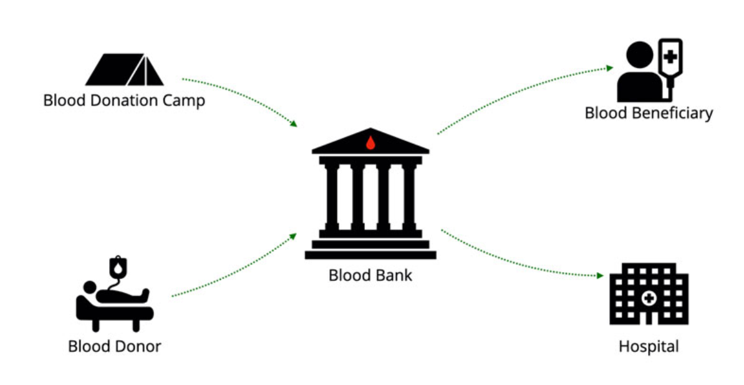

Slide 5
The Objectives :
Maintain project database Donor ,Blood, Blood Donation Camp, Admin
Reduce Manpower and manual paper works for maintaining the records offline
Maintain the accuracy, integrity and consistency of the data
Improve management and control of Inventory and Stock

Slide 6
The Functional Goals
Ensures hospitals have good supply or inventories of blood bags.
List the availability of blood bags at any given time.
Ability to manage the information of its blood donor.
Notify users when blood available in stock

Slide 7
The Features :
Request for Blood
Notification by email
Admin Functionalities
Login , Edit Profile,…
Add , Edit, Delete Blood Donor Details
View Current Blood Request
View Current Blood Request Completed
Blood Stock Module
Admin add new blood stock
See list of blood stock details
Edit, Update the record of blood stock
All blood stocks forms are validated on client side using JavaScript

Slide 8
The Technologies
We follow the MVC model
Model: Responsible of maintaining the blood , admin , blood donation camp , donor
View: Displays the form , reports , login , stocks
Controller: Software Code that controls interactions between view and controller

Slide 9
The Technologies
HTML : Page layout will be design in HTML
CSS : CSS will be use for all the designing part
JavaScript : All the validation task and animations will be develop by JavaScript
JSP : All the front end logic will be writing in JSP
Servlet : All the business logic will be write in JAVA
JavaBean :
MYSQL : MYSQL database will be use as database for the project
Tomcat : project will be run over the Tomcat server

